Slide 1
SY Bus Journey Planner
Group 2
Elekir Moyuwen
Javani Morris
Jack Watson
Samuel Okunowo

Slide 2
Deliverables Overview
Areas | Deliverables
PID (Project Initiation Document) | Methodology, Roles & Responsibilities
Business Case | Force Field Analysis, Options Considered, Investment Appraisal
Project Plan | Work Breakdown Structure, Gantt Chart, COCOMO, RACI Chart
Risk | Risk Management Plan (Risk Map, Risk Register, RAID Log)
Envisioned Solution | Prototype, MoSCoW

Slide 3
Project Initiation Document
Methodology: Prince2 Agile – mix of structure and flexibility.
Overview: SYB Journey Planner – mobile application to improve customer experience and reduce delays.
Business objectives: Better journey info, more digital engagement, accessibility, faster boarding.
Project objectives: Deliver mobile-first application, prototype & project artefacts by Dec 2025, aligned with bus company branding.
Scope: MVP features (routing, next‑bus times, ticket recommendations, live updates).
Notes:
Project overview: Our project is the SYB Journey Planner. The idea is to help passengers plan journeys more easily, cut down on boarding delays, and improve digital engagement for South Yorkshire Buses and their partners.
We chose Prince2 Agile because it gives us the best of both worlds. PRINCE2 gives us structure; clear roles, a live business case, and stage controls. Agile gives us flexibility; short prototype cycles, MoSCoW prioritisation, and regular client feedback. With both of them combined, it means we stay organised but can adapt quickly.
The business objectives are simple: to provide clear journey information, encourage people to buy tickets before boarding, and make sure the app is accessible to everyone.
The project objectives are what we’re delivering in this module; a high‑fidelity prototype and all the project management artefacts; things like the business case, WBS, Gantt chart, risk and quality plans.
In terms of scope, we’re keeping it focused on MVP features: routing from A to B, next‑bus times, ticket recommendations, and live updates. Payment integration and native apps are out of scope for now.

Slide 4
Project Initiation Document
Roles & responsibilities:
Jack – Project Manager
Javani – Sponsor (budget/approvals)
Elekir – Business Analyst
Samuel – Quality Assurance
Designer – Wireframes & prototype
Risk Manager – RAID & risk register
Software Team – Code review and evaluations
Notes:
Roles and responsibilities: Jack is our Project Manager, keeping the plan on track. Javani is the Sponsor, handling budget costs and approvals. Elekir is the Business Analyst, gathering requirements. I’m leading Quality Assurance, making sure accessibility and testing are covered. Our Designer handles wireframes and prototypes, the Risk Manager maintains the RAID log, and the Software Team looks at technical feasibility like APIs and hosting.
Summary: Prince2 Agile gives us the framework, our objectives keep us focused, and our roles make sure every part of the project is covered.

Slide 5
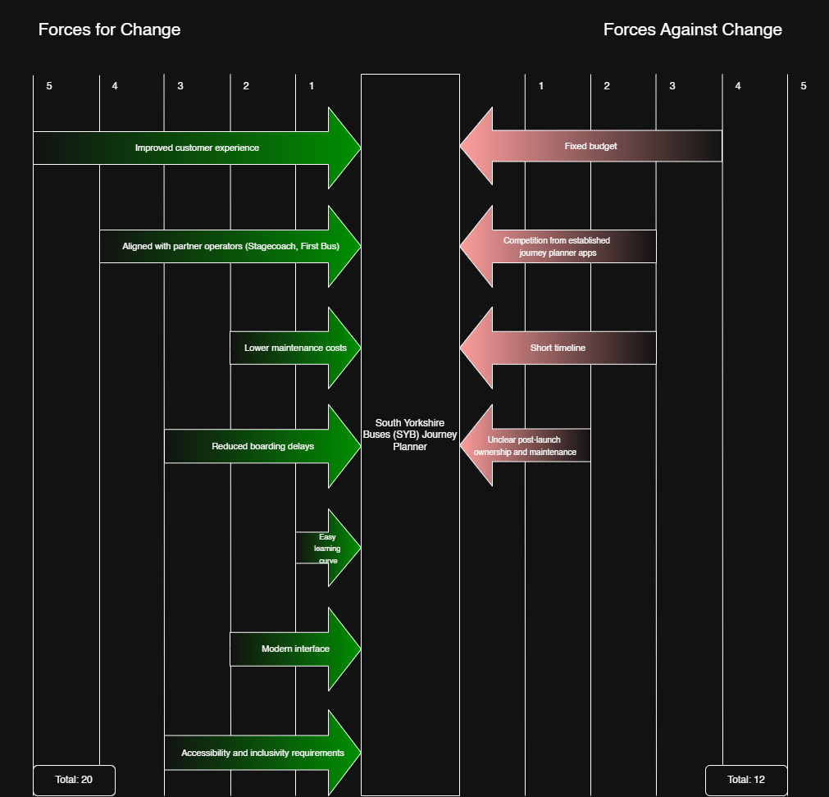
Business Case – Force Field Analysis
Forces For Change:
Improved customer experience – Clear Journey Info
Alignment with existing operators (Stagecoach, First Bus)
Meeting accessibility requirements
Forces Against Change:
Fixed Budget (£65,000)
Short Delivery Timeline (mid-December 2025)
Strong competition from established apps
Uncertainty about post-launch ownership/maintenance
Notes:
As part of our Business Case, this slide shows our force field analysis for the SYB Journey Planner, where we scored the main forces pushing for and against the project. Overall, the forces for change total 19 and the forces against total 12, so the drivers for the project are noticeably stronger than the barriers.
On the left, the strongest drives are improved customer experience, alignment with existing operators like Stagecoach and First Bus, and meeting accessibility requirements.
We also expect practical benefits such as reduced boarding delays, lower enquiry volumes, and a more modern digital brand for SYB.
On the right, the main barriers are the fixed budget, a short delivery timeline, strong competition from established journey-planner apps, and uncertainty about who would own and maintain the system after launch.

Slide 6

Business Case – Options Considered
Option A:
Do nothing
No upfront cost
No improvement to customer experience/accessibility
Fails to address barriers identified
Option B:
Minimal Change – Web timetable Website
Low cost, Low effort (Small UI updates)
Convert current bus timetables into a basic responsive website (no live routing or tickets)
Option C:
Envisioned Solution – Journey Planner App
Mobile-first application, high-Fidelity Prototype + Complete management artefacts
Demonstrates feasibility with concrete evidence
MVP approach: real value at lower risk
Notes:
As part of our Business Case, we followed PRINCE2 Agile guidance which says we should evaluate a range of delivery options before selecting the most appropriate solution.
We considered three options. The first was to ‘Do Nothing’, where SY Bus continues with the current system. There is no upfront cost, but it delivers no improvement to customer experience and accessibility. Making this not viable given the forces for change we identified.
The second was a ‘Minimal Enhancement’ which would add small UI updates, making this low-cost and low-effort. It does not address the core user needs such as live routing, ticket purchasing or alignment with partner operators. So, the client still faces the barriers we identified, particularly budget pressure and competition.
Our preferred option, which is what our project delivers, is the ‘Envisioned Solution – Journey Planner App’ featuring a Mobile-first Journey Planner application, High-Fidelity prototype and complete management artefacts. This option demonstrates feasibility and provides the client with concrete evidence. In Prince2 Agile terms, this is the right balance as we deliver real value at lower risk than committing fully to a product upfront, as well as remaining open to any feedback.

Slide 7
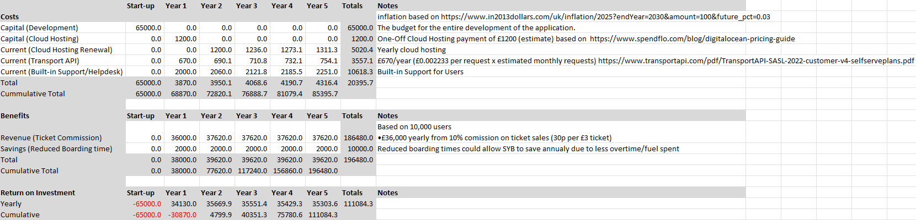
Business Case – Cost Benefits Analysis
Costs:
Capital:
  Development: £65,000 (fixed budget)
  Cloud Hosting (Yr 1): £1,200
Recurring (Years 1-5):
  Cloud Hosting Renewal: £1,200/year
  Transport API (Map): £670/year
  Built-in Support/Helpdesk: £2,000/year
  Total recurring: £4,000/£5,000/year (grows with inflation)
Benefits:
Revenue Streams:
  Ticket Commissions: £36,000/year (10% on £3 tickets x 10,000 users)
Cost Savings:
  Faster Boarding: £2,000/year (reduced time stationary leading to lower overtime/fuel costs)
Financial Outcome:
Year 1 Loss: £30,000
Year 2-5: Exceeding costs (£34,000-£35,000 annually)
5-year cumulative return: £110,000 (1.7x ROI)
Notes:
Our Cost-benefit Appraisal goes over the potential Costs and Benefits of our project.
On Costs: The Initial development budget is £65,000 which the client approved. From Year 1 onwards, we have recurring costs for cloud hosting, the Transport API for mapping, and customer support. These total around £4-5,000 per year and grow with inflation.
On benefits: We projected two Revenue and Savings streams. For Revenue we decided ticket commissions of approximately £36,000 per year, based on 10,000 users purchasing tickets at 10% commission. We also included a small operational saving of around £2000 from faster boarding due to the journey planner assisting passengers with deciding their route and their ticket in advance, drivers spend less time stationary potentially making annual savings from lower overtime/fuel.
Financial Outcome: Year 1 shows a loss of roughly £30,000 with the revenue from year 2 onwards exceeding costs. Over the full five-year period, the project generates just over £100,000 giving a strong positive return on the £65,000 budget.

Slide 8
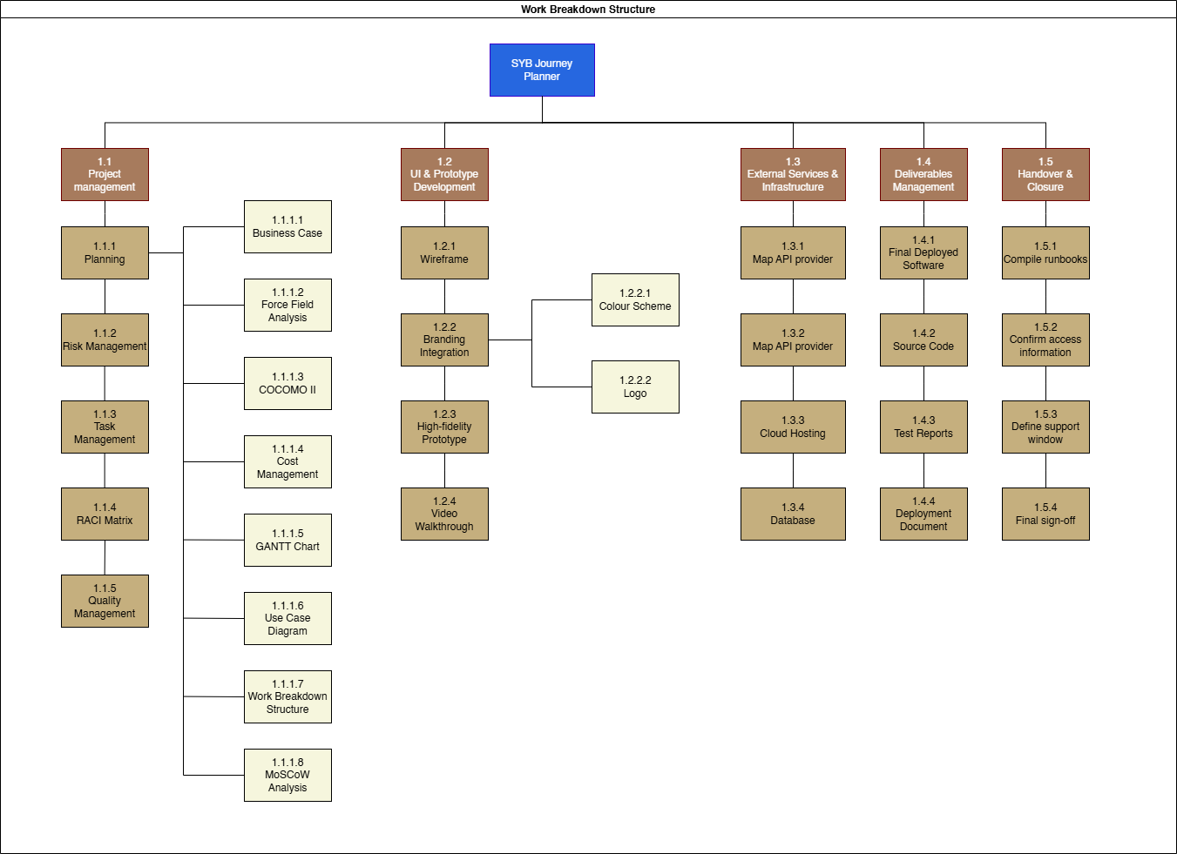
Project Plan – Work Breakdown Structure (WBS)
The Structure: Hierarchical Decomposition
The WBS is a deliverable-oriented hierarchical decomposition of the work required to accomplish the project objectives and create the required deliverables.
The Core Unit: Work Packages
Work Packages are the fundamental level of control and effort estimation in the project.
The Workflow
The WBS logically follows the project lifecycle
Notes:
a work
breakdown structure (WBS) showing the work required
to produce them.
Intro
* The Work Breakdown Structure (WBS) is the foundation of our project plan, defining the total scope of work required to achieve the project objectives.
* Our initial focus is on Project Planning, which establishes the roadmap for execution.
This phase ensures we have clear objectives, measurable deliverables, and well-defined processes before development begins
Work package
Measurable Output: They are the smallest, specific, and manageable pieces of work that result in a defined deliverable or product (e.g., 'GANTT Chart', 'Wireframe', 'Source Code').
Estimation & Assignment: At this level, it is possible to accurately estimate the cost, duration, and resources needed, and assign the work to a specific individual or team.
Control Point: All progress tracking and earned value calculations happen at the Work Package level.
Workflow
The WBS logically follows the project lifecycle, starting with 1.1 Project management (Planning/Definition) and moving through 1.2 Development and 1.3 Infrastructure, before concluding with 1.4 Deliverables (Testing/Deployment) and 1.5 Handover & Closure.
Inputs and Outputs: Completion of early work packages (e.g., 'Business Case' in 1.1) provides the necessary inputs for subsequent work packages (e.g., 'High-fidelity Prototype' in 1.2).
Progressive Elaboration: The WBS moves from high-level deliverables (top) to detailed tasks (bottom), allowing for progressive elaboration as the project moves forward and more is learned.

Slide 9
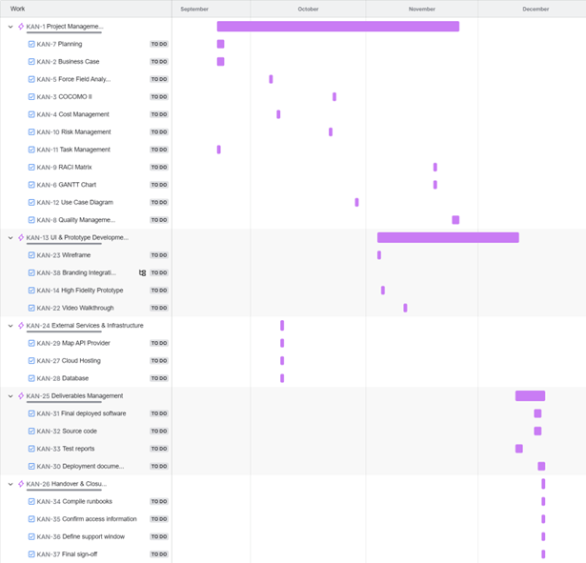
Project Plan – Gantt Chart
Visual Schedule & Timeline
Provides a graphical representation of the entire project, with the schedule timescale (weeks/months) on the horizontal graph
Task List & Duration
Lists all project tasks (derived from the WBS) vertically, with horizontal bars showing the planned start date, duration, and end date for each activity
Dependencies and Sequence
Clearly illustrates the logical sequence and dependencies between tasks, ensuring the team knows the correct order of work.
Notes:
Intro: "The Gantt Chart is our primary tool for scheduling and tracking the execution phase. It converts our WBS tasks into a dynamic, manageable timeline."
Schedule & Duration: "The chart's visual layout allows stakeholders to see the entire project duration at a glance. The length of each bar is a direct representation of the effort and time allocated, as determined by our COCOMO estimates."
Dependencies: "Dependencies are crucial. For example, the UI Development cannot begin until the Wireframe Sign-off is complete. This visual link ensures we don't start work prematurely, which is a common cause of project delays."
Milestones & Critical Path: "We mark major accomplishments, such as 'Prototype Sign-off', as Milestones (often shown as diamonds) to keep everyone focused on key deadlines. Most importantly, the Gantt chart clearly identifies the Critical Path. Any delay on a critical path task will immediately delay the entire project completion date."
Monitoring: "This chart acts as a control tool, allowing us to compare Planned vs. Actual progress in real-time, enabling prompt corrective action when we fall behind schedule."

Slide 10
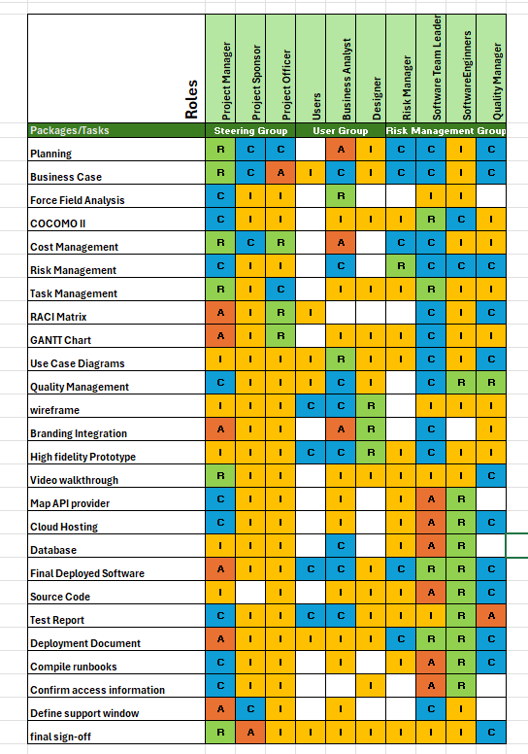
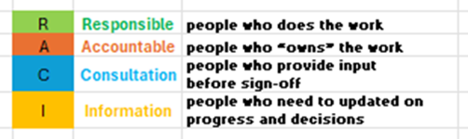
Project Plan – RACI Matrix
IT Project Roles
Organising the Roles
Steering Group
User Group
Risk Management Group
Work Package Assignment
Responsible
Accountable
Consulted
Informed

Slide 11
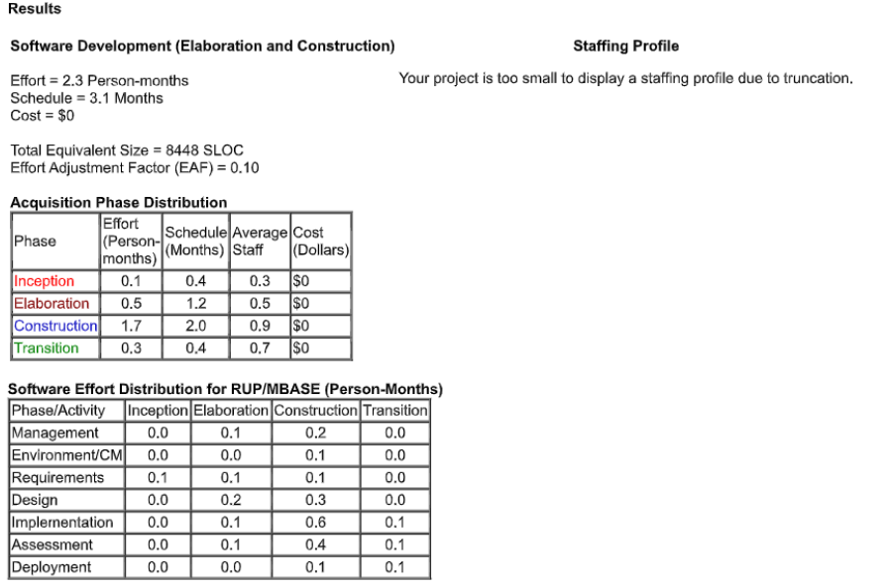
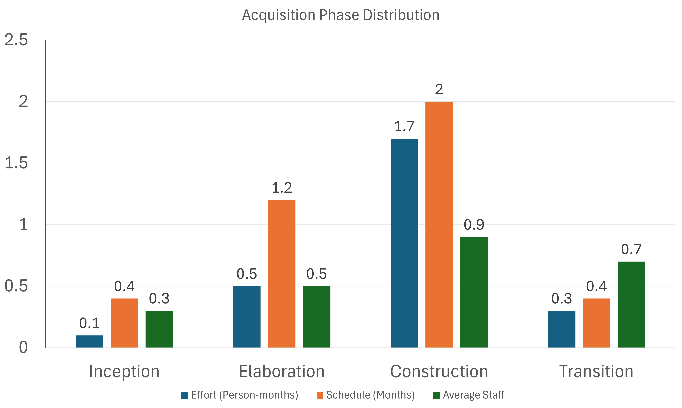
Project Plan – COCOMO Estimate
Quantitative Estimation Tool:
COCOMO II (Constructive Cost Model) is an algorithmic model used to provide a data-driven estimate of project scale and effort.
Core Results:
The model estimates the software development phase will require: Effort: 2.3 Person-Months of work. Schedule: A duration of 3.1 Months until completion.
Basis of Estimate:
This calculation is based on an estimated project size of 8448 SLOC (Source Lines of Code) and an Effort Adjustment Factor (EAF) of 0.10.
Effort Distribution:
The work is distributed across the phases, focusing heavily on Construction (1.7 Person-Months) and Elaboration (0.5 Person-Months), which informs our resource loading.
Integration with Planning:
These results are crucial inputs for: Defining Task Durations in the GANTT Chart. Determining the required Staffing Profile (team size) for our Resource Plan.
Notes:
Introduction: "This slide shows the quantitative backbone of our project plan. We used the COCOMO II model to move beyond guesswork and establish objective estimates for our effort and schedule."
Core Results: "The primary outputs are 2.3 Person-Months of total effort and a 3.1-month schedule. This indicates that given the project's small size (8448 SLOC), we are looking at a tightly scheduled, focused development effort."
Phase Distribution: "Looking at the breakdown, the majority of the work (74%) is concentrated in the Construction phase (1.7 PMs), which is where the coding and core feature implementation of the 'SYB Journey Planner' will occur. This tells us exactly when we need our core development team to be fully engaged."
Planning Impact: "The 3.1-month schedule is the key input for our overall project timeline and the high-level bar on the GANTT Chart. The required effort of 2.3 Person-Months helps us determine the optimal team size needed to meet that 3.1-month deadline without causing resource burnout."
Conclusion: "By leveraging COCOMO II, we ensure our schedule and cost estimates are grounded in industry-tested metrics related to the size and complexity of the software."

Slide 12
Risk Management Plan – Risk Register
Identify Risks
Assign ID and description for each risk
Determine how likely (probability) the risk and the impact it would have on project.
Determine how to deal with/respond to the risk.
Largest risks for this project were Scope Creep and Communication Issues.
Notes:
On this right-hand side of this slide, you can see the Risk Register. This is a list of our identified risks to the project. For each risk we assigned a unique ID, a description for the risk so that you know what the actual risk is, a probability value for how likely the risk is to occur, an impact value for how much damage it would cause to the project if that risk were to become a reality, a category which helps stress how much of a problem the risk poses and therefore how much focus it should have and finally a response for each risk such as attempting to reduce the likelihood of the risk, avoid the risk, transfer the risk elsewhere, creating a contingency plan for the risk or accepting that the risk exists and essentially leaving that risk unchecked/not tackling the risk.
The highest priority risks for the project are Scope Creep and Communication Issues. To tackle these risks, it involves attempts to reduce the likelihood of them occurring. For Scope Creep, we would evaluate what is currently in the scope and approve or reject changes based on how much they’d cause a scope creep issue. For Communication Issues, the way to reduce the likelihood is through maintaining open communication between team members and with the client.
The lowest risks were Vague Information regarding requirements and Acts of Nature. To tackle vague information, we simply have to reduce the risk by seeking clarification for the requirements. For the acts of nature, it is even simpler – we just accept that there’s nothing we can do to prevent any complications as we are not able to control storms or earthquakes etc.

Slide 13
Risk Management Plan – Risk Map
Visualizes the probability, impact and category for identified risks in Risk Register.
Assign a rating based on how severe the risk is.
Intention is to quickly classify risks and know which ones need the most focus.
Notes:
The next two slides are directly related to the risk register, so I will try not to repeat what we’ve just discussed and instead summarise what the artefacts do with the risks we registered. On this slide you can see the Risk Map which was created for this project. It categorises the identified risks from the previous slide (the ones in risk register, in order sorted by their ID) based on their likelihood of occurring and the impact which they’d have on the project.
We also add a Rating value to each risk and these ratings go up in severity so 0 or 1 is on the lower end and in our case 15 or above are the higher risks.
The purpose of the risk map is to allow us to quickly see where the threats to the project lie and therefore be able to put our focus where it is most required.

Slide 14
Risk Management Plan – RAID Log
Expands upon risks in detail.
Assign a RAID Category; Risk, Actions/Assumptions, Issues or Decisions/Dependency.
Assign an owner (someone within the team who is responsible/allocated to the risk)
Assign priority value and therefore Risk Priority Number to each risk.
Assign a status value whenever the ‘status’ of the risk is updated.
Notes:
The final artefact as part of the Risk Management Plan is the RAID Log. This expands on the identified risks from the Risk Register into higher detail. This is done by assigning a RAID Category to each risk which can be either Risk, Actions/Assumptions, Issues or Decisions/Dependency. We also assign an owner to each identified risk – the owner is a member of the team within the project. In addition to the owner, we also assign a priority value for how urgent the risk is based on all factors we’ve discussed, and they can then be assigned a risk priority number to order them accordingly. Finally, there is the Status value which is updated according to any developments when dealing with the risk.
There are no issues within this RAID Log and this is because an issue would be any risk which has progressed from a potential risk to an actual threat occurring because of that risk becoming reality.

Slide 15

Envisioned Solution

Slide 16
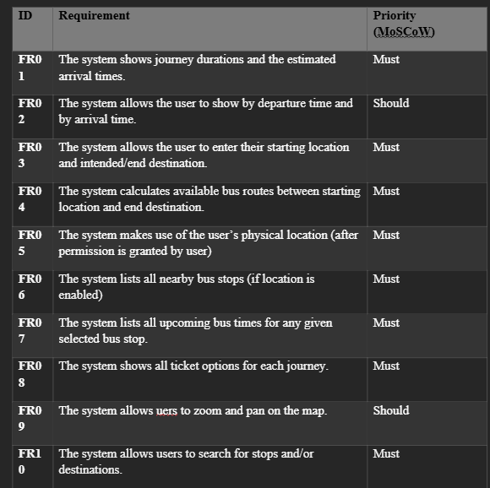
MoSCoW
The Categories and Commitment:
Application to 'SYB Journey Planner' Requirements:
Most of our core functionality is classified as Must Have to ensure the initial product is viable
Integration with WBS
ensuring developers focus their effort strictly on implementing the Must Have requirements before moving on to lower priority items
Notes:
Intro: "Effective project execution starts with knowing what to build first. We used the MoSCoW technique to give clear priorities to the functional requirements for the 'SYB Journey Planner' system."
Categories: "The technique is essential for managing scope creep and delivering a viable product on time. We commit to delivering all the 'Must haves'. If a Must Have is compromised, the project objectives cannot be met."
Must Haves Examples: "As shown in the table, examples of Must Haves are fundamental features like calculating available bus routes (FR04) and using the user's location to list nearby bus stops (FR05/FR06). These are non-negotiable for a functioning journey planner."
Should Haves Examples: "Should Haves, like allowing the user to search by departure time (FR02) or zoom/pan (FR09), are important for a good experience but can be delivered in a subsequent release if necessary."
Impact: "By prioritizing this way, we ensure our limited time and effort (as estimated by COCOMO) is spent only on the features that provide the highest value and ensure the project's critical objectives are met on schedule."

Slide 17
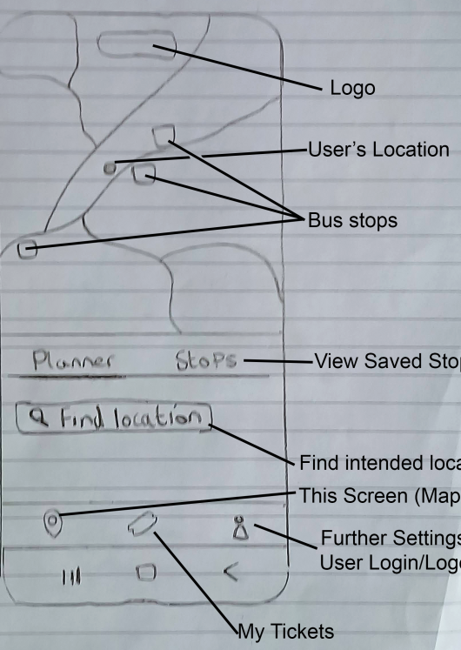
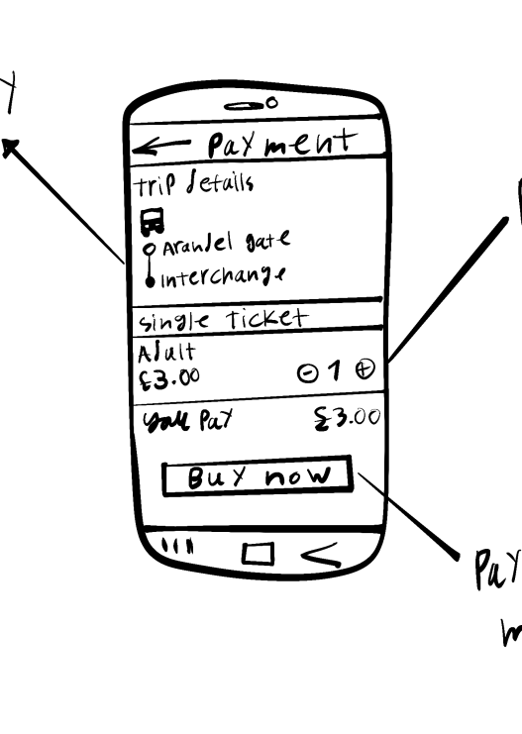
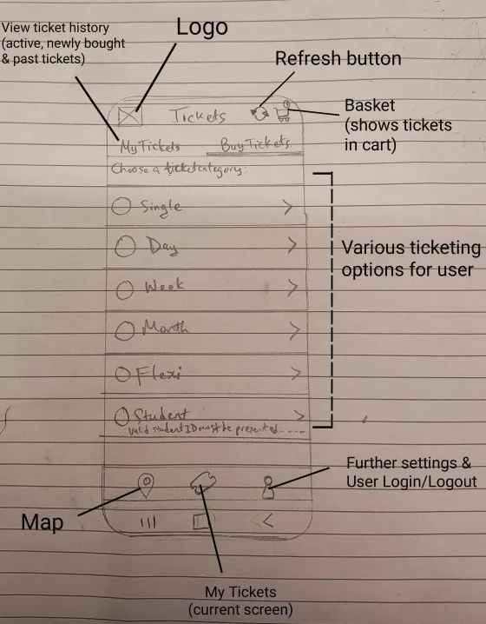
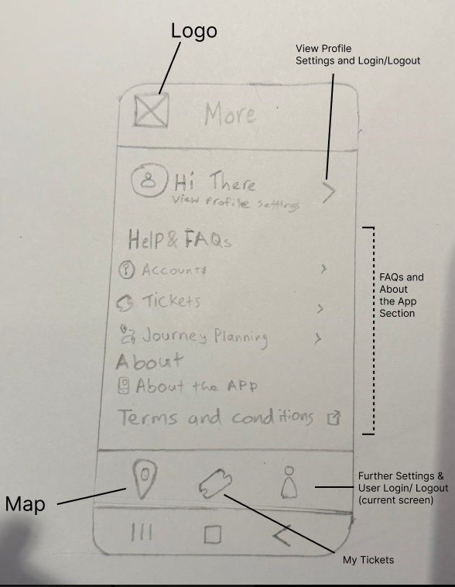
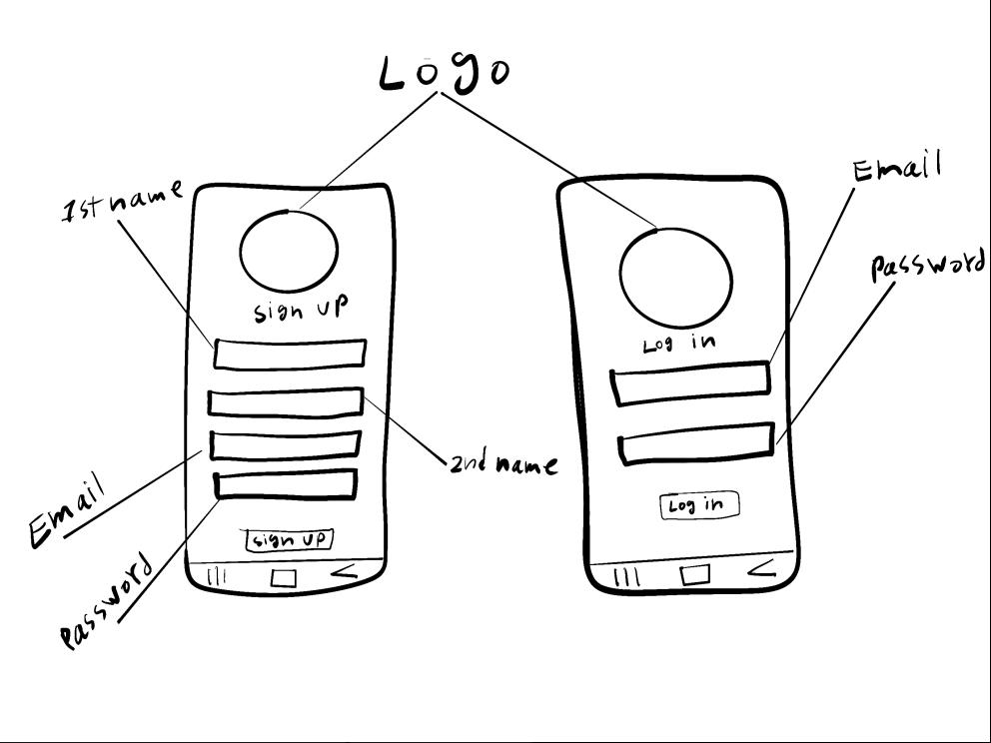
Low Fidelity Prototype

Slide 18
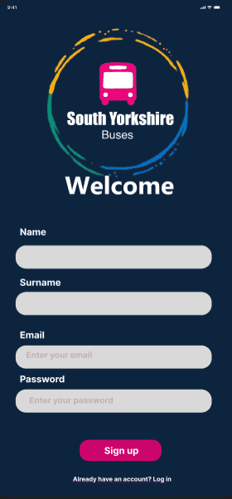
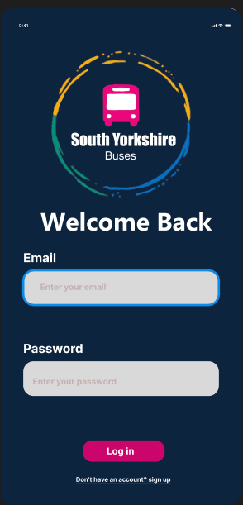
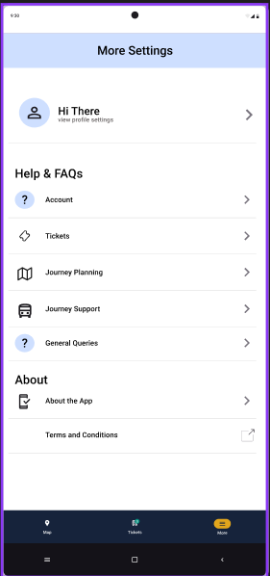

High Fidelity Prototype

Slide 19
High Fidelity Prototype
-High Fidelity Video-

